Slide 1
Life is a struggle
Credit makes it less of a hassle

Slide 2
CS&T Holding

Slide 3
Who is Credit Systems and Techniques?
Established in 1997 in Beirut - Lebanon, Credit Systems and Techniques (CS&T) is today a HOLDING company with subsidiaries existing in MANY regional countries.
1
Overview
2
Key Values
Group Services
CS&T was first created as a Third Party Administration company (TPA) to SUPPORT insurance companies in the MANAGEMENT of their credit portfolios.
Departments
Database
Why CST
Facts
CS&T currently owns several companies which businesses involve in addition to TPA, Brokerage, Marketing and Financing.
CST Clients
Contacts

Slide 4
Our Group
1
Overview
CST SAL Lebanon
2
Key Values
Lebanon
Group Services
Loans
Jordan
Departments
Database
Egypt
Why CST
Facts
CST Clients
Contacts

Slide 5
CS&T Group Services
Overview
CST (All Countries)
Credit Insurance Administration (TPA)
Credit Investigation
I&I Lebanon & Jordan
Insurance Consultants & Brokers
Credit Scoring
Debts Monitoring & Follow up
Promissory Notes Collection
Bad Debts Recoveries
Full Range of Statistics
Statistics Analysis
Byoutna Lebanon
Financial Products Development
CST Loans Lebanon
Micro-Loans Financing
Credit Insurance Loss Adjusters
Marketing
Key Values
Group Services
Departments
Database
Why CST
Facts
CST Clients
Contacts

Slide 6
Key Values
CS&T key values have always been:
know-how,
integrity and
professionalism
… and this is how we hope to serve you best
Overview
Key Values
Group Services
Departments
Database
Why CST
Facts
CST Clients
Contacts

Slide 7
Credit Insurance
Overview
Coverage
Advantages to Insured
Advantages to Insurance co
Advantages to Reinsurance co

Slide 8
What is credit insurance?
Credit Insurance is a HEDGE made by banks, Financial Institutions and Traders against credit losses.
Overview
Coverage
Credit Insurance provides PROTECTION for the repayment of loans made by Banks, financial institutions or traders, following the borrower’s insolvency or PAYMENT DEFAULT.
Advantages to Insured
Advantages to Insurance co
Advantages to Reinsurance co

Slide 9
What Does Consumer Credit Insurance Cover?
All types of loans (Retail) such as:
Overview
Coverage
Advantages to Insured
Advantages to Insurance co
Car Loan
Education Loan
Personal Loan
Credit Cards
Consumer loans such as:
Advantages to Reinsurance co
Home Appliances
Furniture Loan
Travel Loan
Other …

Slide 10
What Does Consumer Credit Insurance Cover?
Business to business facilities (Trade Credit)
Overview
Trade credit insurance provides protection of accounts receivable (sales to buyers on credit) from losses due to credit risks, such as default, insolvency and bankruptcy.
The buyers can be in the same country of the insured business (domestic trade) or in another country (export).
Coverage
Advantages to Insured
Advantages to Insurance co
Advantages to Reinsurance co

Slide 11
Advantages to the Insured
Overview
TRANQUILITY TO THE INSURED
Coverage
Money and time SAVING
Advantages to Insured
No worry about legal aspects
Advantages to Insurance co
Indemnity in case of payment default
Advantages to Reinsurance co

Slide 12
Advantages to Insurance Companies
1
Overview
Cost Effective
Recovery
Marketing
Selection
Claims Handling
Follow up
Monitoring
Know How
Collection
2
Coverage
Advantages to Insured
Advantages to Insurance co
Advantages to Reinsurance co

Slide 13
Advantages to Insurance Companies
1
Overview
2
Credit reinsurance support to insurance companies
Credit insurance technical support
Reporting and full range of statistics
Specialized software and sophisticated personal data base
Committed to confidentiality of information
Coverage
Advantages to Insured
Advantages to Insurance co
Advantages to Reinsurance co

Slide 14
Advantages to reinsurance companies
1
Overview
Selection
Monitoring
FOLLOW UP
COLLECTION
CLAIMS HANDLING
Recovery
Underwriting
2
Coverage
Advantages to Insured
Advantages to Insurance co
Advantages to Reinsurance co
PORTFOLIO CONTROL

Slide 15
Advantages to reinsurance companies
1
Overview
Diversified and Geographically spread risks
Reporting and full range of statistics
Introduction of new cedAntS leading to cooperation on CLASSIC lines
Specialized software and sophisticated personal database
2
Coverage
Advantages to Insured
Advantages to Insurance co
Advantages to Reinsurance co

Slide 16
Departments
Overview
Underwriting
Legal
Reinsurance and Statistics
IT
Accounting
Quality Control
Monitoring, Follow-Up and Claims Recovery
Production and selection
Regional Division
Public Relations
Claims Processing
Key Values
Group Services
Departments
Database
Why CST
Facts
CST Clients
Contacts

Slide 17
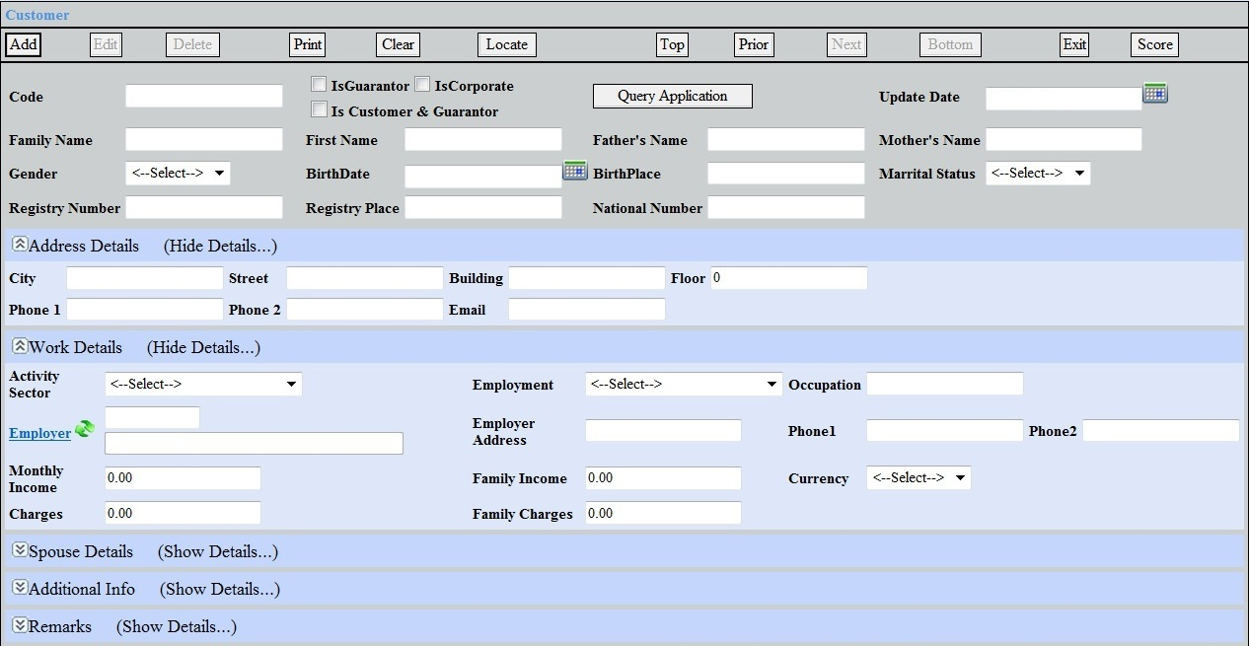
Database
1
Overview
2
Key Values
3
Group Services
4
5
Departments
6
Database
Why CST
Facts
CST Clients
Contacts

Slide 18
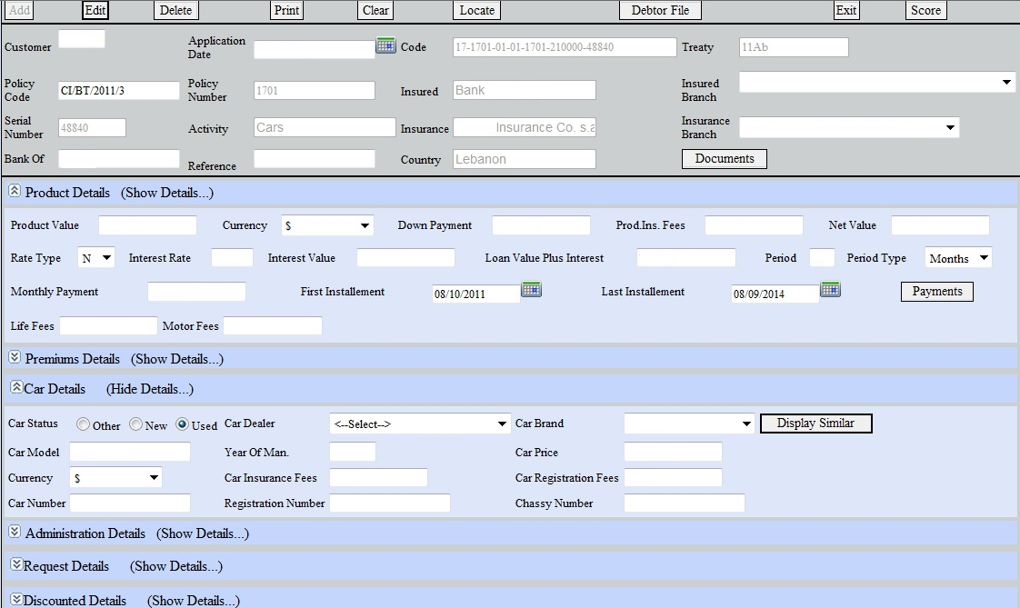
Database
1
Overview
2
Key Values
3
Group Services
4
5
Departments
6
Database
Why CST
Facts
CST Clients
Contacts

Slide 19
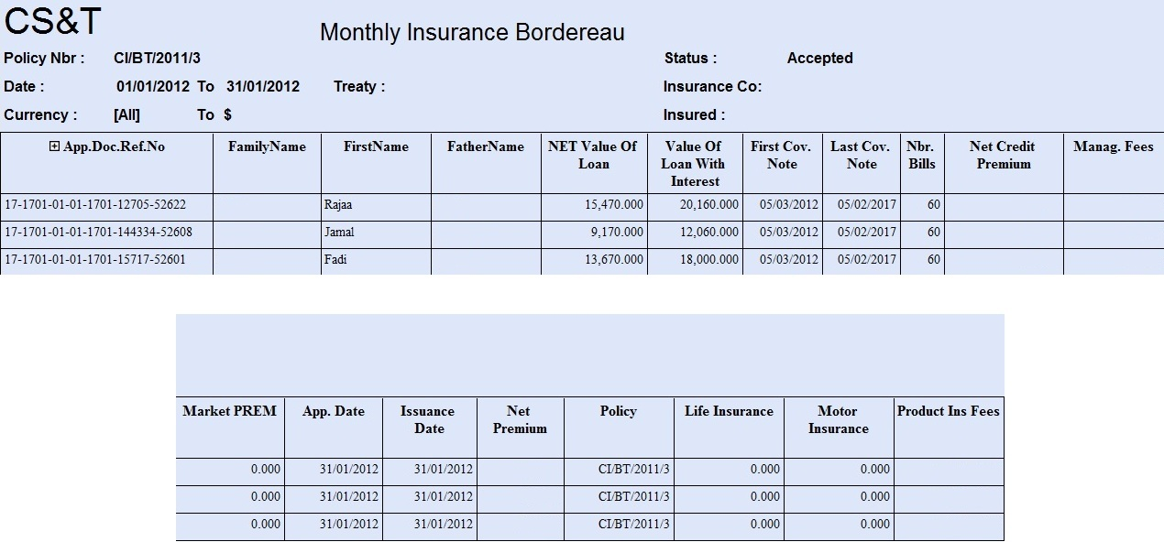
Database
1
Overview
2
Key Values
3
Group Services
4
5
Departments
6
Database
Why CST
Facts
CST Clients
Contacts

Slide 20
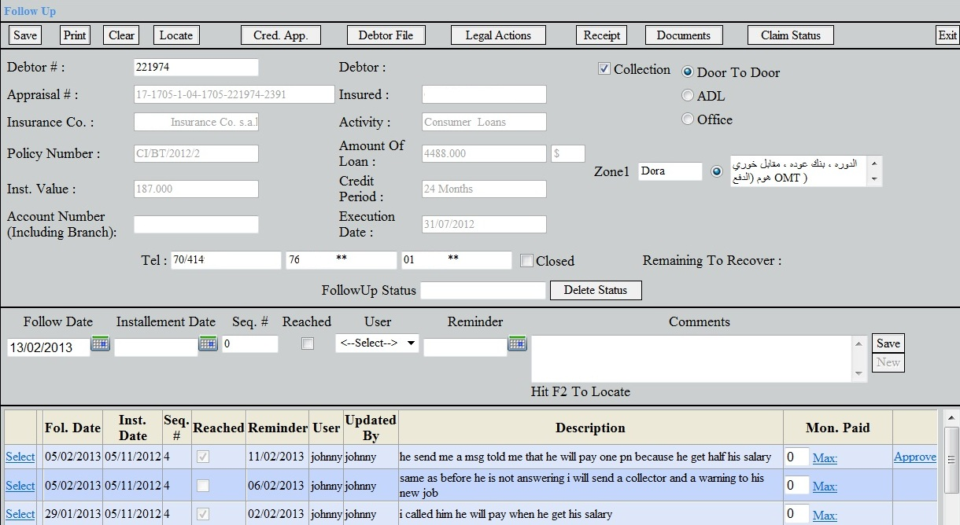
Database
1
Overview
2
Key Values
3
Group Services
4
5
Departments
6
Database
Why CST
Facts
CST Clients
Contacts

Slide 21
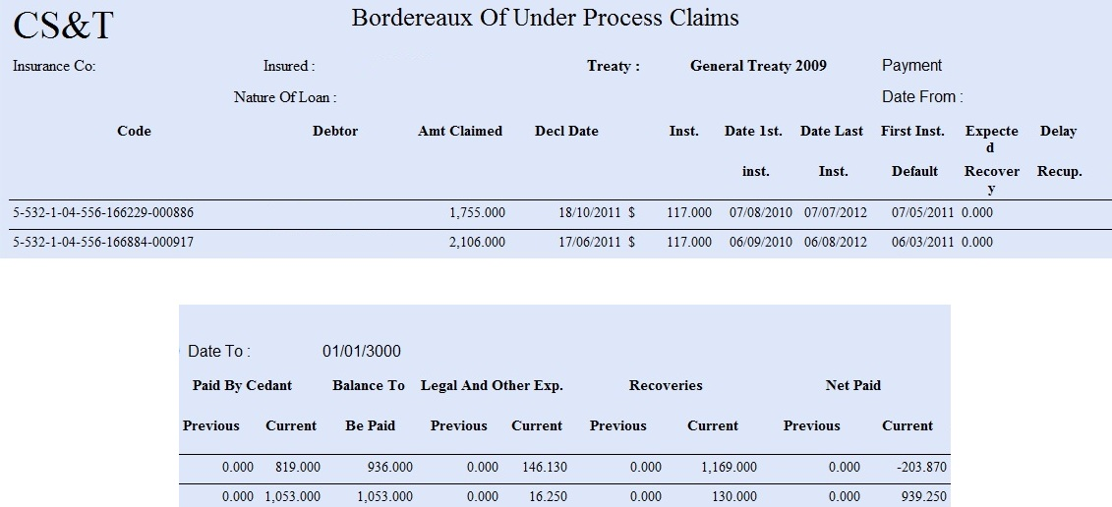
Database
1
Overview
2
Key Values
3
Group Services
4
5
Departments
6
Database
Why CST
Facts
CST Clients
Contacts

Slide 22
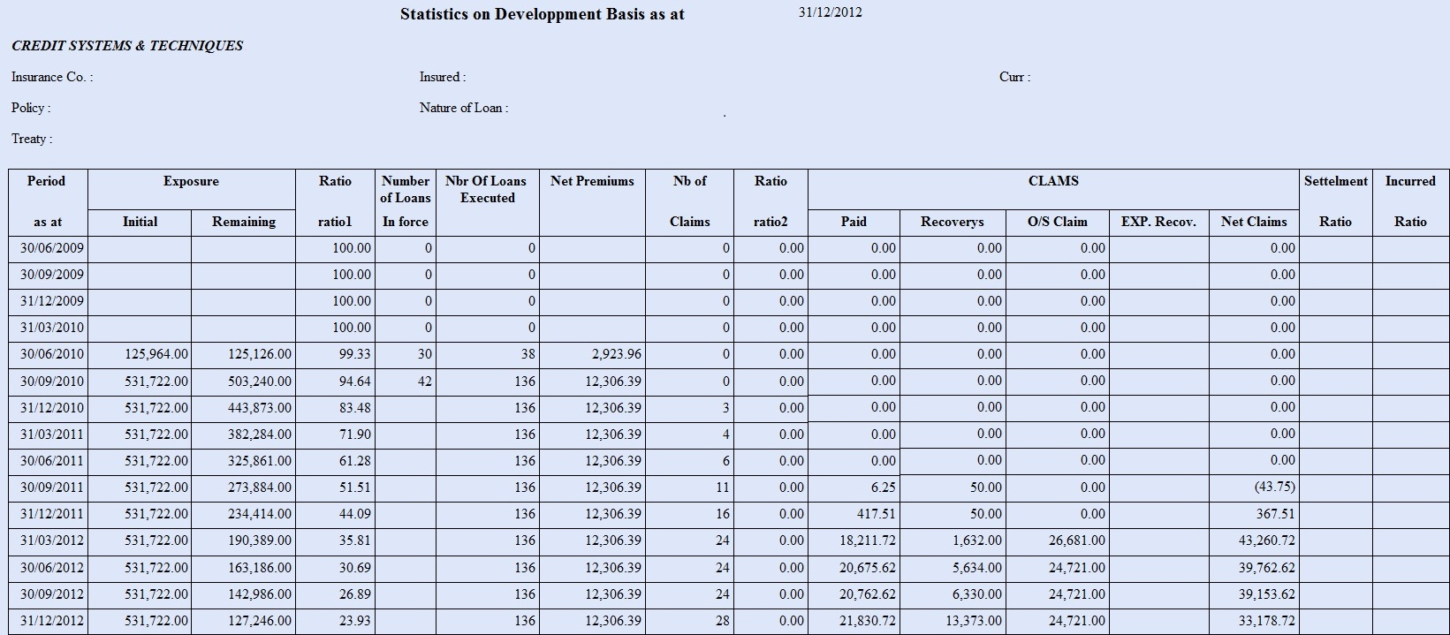
Database
1
Overview
2
Key Values
3
Group Services
4
5
Departments
6
Database
Why CST
Facts
CST Clients
Contacts

Slide 23
Why Choose Credit Systems and Techniques
The sole credit insurance TPA in the MENA region
Overview
Professional expertise in the management of Corporate and Individual credit
Key Values
Most Reinsurers dealing with Trade and Retail Credit Insurance require that CS&T be the credit administrator
Group Services
Departments
Acts as the true and effective back office to the Insurance and the Insured
Database
Long term reliable relationship with investigation companies
Why CST
Long term reliable relationship with Reinsurers
Facts
Large database with credit history
CST Clients
Acts as an efficient go – between among involved parties
Contacts
Several lawyers engaged for recoveries

Slide 24
Facts
Over half a million credit application assessed
Overview
Key Values
CST is the sole credit insurance TPA in the MENA region
Group Services
Over 50% rate of recovery – ongoing
Departments
Have been managing over USD 1 billion of credit portfolio
Database
Specialized in-house developed software
Why CST
Treated over 3000 claims
Facts
21 years of operation
CST Clients
Contacts

Slide 25
Insurance Companies Utilizing CS&T TPA Services
AL MASHREK INS & REINS, Lebanon
1
Overview
ARABIA INSURANCE, Lebanon
2
Key Values
3
AROPE INSURANCE, Lebanon
Group Services
4
MEDGULF INS & REINS, Lebanon
Departments
THE ARAB ASSURERS, Jordan
Database
DELTA INSURANCE, Jordan
Why CST
Jordan International Insurance Company (Newton), Jordan
Facts
ARAB MISR INSURANCE GROUP (GIG), Egypt
Iskan Insurance, Egypt
CST Clients
United Insurance Company, Egypt
Contacts

Slide 26
Insurance Companies Utilizing CS&T TPA Services
UR INTERNATIONAL INSURANCE, Iraq
1
Overview
Bahrain National Insurance, Bahrain
2
Key Values
3
Enaya Insurance, Kuwait
4
Group Services
Doha Insurance Company, Qatar
Departments
Database
Why CST
Facts
CST Clients
Contacts

Slide 27
Banks, Financial & Trade Companies Utilizing CS&T TPA Services (Lebanon)
1
Overview
BANK OF BEIRUT
2
Key Values
BLOM BANK
3
Group Services
BML BANK
4
CREDIT LIBANAIS
Departments
AL BARAKA BANK
Database
CST FOR LOANS
Why CST
Kettaneh (Pharma)
Facts
Tamer Freres
CST Clients
Mideast Power Systems (ITG Group)
ALLCHEM
Contacts
Protel

Slide 28
Banks, Financial & Trade Companies Utilizing CS&T TPA Services (Egypt)
1
Overview
BLOM BANK
2
Key Values
BAVARIAN AUTO GROUP
3
Group Services
Dabur Egypt
4
Departments
Sanita Egypt (Indevco group)
Database
Unipacknile Egypt (Indevco group)
Why CST
Facts
CST Clients
Contacts

Slide 29
Banks, Financial & Trade Companies Utilizing CS&T TPA Services (Jordan & Iraq)
BLOM BANK, Jordan
1
Overview
SOCIETE GENERALE DE BANQUE, Jordan
2
Key Values
3
CAPITAL BANK OF JORDAN
Group Services
4
EGYPTIAN ARAB LAND BANK
Departments
Database
NATIONAL BANK OF IRAQ
Why CST
Facts
CST Clients
Contacts

Slide 30
Banks and Companies Utilizing CS&T Bad Debts Recovery and Other Services
BLOM BANK Lebanon
1
Overview
Bank Audi - Audi Saradar Group
2
Key Values
3
AROPE INSURANCE COMPANY
Group Services
4
BEKDACHE GROUP
Departments
SHOUF NATIONAL COLLEGE
Database
F.A KETTANEH (VW, PORSH, SCODA)
Why CST
ETS. GABRIEL ABOU ADAL (VOLVO)
Facts
CESAR DEBBAS & FILS
CST Clients
BANQUE MISR LIBAN (BML)
Contacts
BLOM BANK Jordan

Slide 31
Installments
& Insurance
Why I&I
Types of Insurance Policies
Insurance Companies

Slide 32
Why Insure through I&I
Why I&I
Installment & Insurance Provides professional insurance consultancy and efficient after sales service
We provide protection through first class insurance companies and allow payment facilities
We guarantee the best prices coupled with expertise and service
Our team of professionals is totally dedicated
Types of Insurance Policies
Insurance Companies

Slide 33
Types of Insurance Policies
Why I&I
Aviation |  | Medical Insurance
C.A.R. (Contractors All Risk) |  | Money Insurance
Credit Insurance |  | Motor
D.B.A. (Defense Base Act) |  | Personal Accident
Expatriate Insurance |  | Professional Liability
Liability |  | Property (Fire & Burglary)
Life Insurance |  | Travel Insurance
Marine & Hull Insurance |  | Workman's Compensation
Types of Insurance Policies
Insurance Companies

Slide 34
Insurance Companies (Lebanon)
AL MASHREK INSURANCE & REINSURANCE
1
Why I&I
AMANA INSURANCE
2
ARABIA INSURANCE
Types of Insurance Policies
BANKERS ASSURANCE
Insurance Companies
COMPASS INSURANCE
MEDGULF INSURANCE
SECURITE ASSURANCE
VICTOIRE ASSURANCE

Slide 35
Insurance Companies (Jordan)
DELTA INSURANCE
1
Why I&I
THE ARAB ASSURERS
2
JORDAN EMIRATES INSURANCE
Types of Insurance Policies
ARAB ORIENT INSURANCE
Insurance Companies
Medgulf Insurance
First Insurance
Newton Insurance

Slide 36
Byoutna
Overview
Financing Providers
Merchant Partners

Slide 37
Who is Byoutna
Overview
Financing Providers
Merchant Partners
marketing company specialized in financial products, targeting low to middle income individuals wishing to purchase products and services for their households and families.
Support small traders wishing to improver their businesses.

Slide 38
Financing providers
Overview
Financing Providers
Merchant Partners

Slide 39
Byoutna Merchant Partners
Byounta established a network of small to medium size merchants who sells products or services to their clients and require financing.
Overview
Financing Providers
The Network includes the following types of merchants:
Merchant Partners
Home Appliances
Travel Agents
Photographers
Furniture
Opticians
Sporting Goods

Slide 40
CST for LOANS (CSTLOANS)
Overview
Types of Loans

Slide 41
Who is CST Loans
Overview
CST for LOANS is a Lebanese lending company specialized in providing microloans to persons and companies with good credit standing at conditions substantially better than those of the microfinance industry
Types of Loans

Slide 42
Types of Loans Financed by CST Loans
Overview
Types of Loans
Car Loan
CONSUMER Loan
Personal Loan
MICRO LOANS
Business LOANS

Slide 43
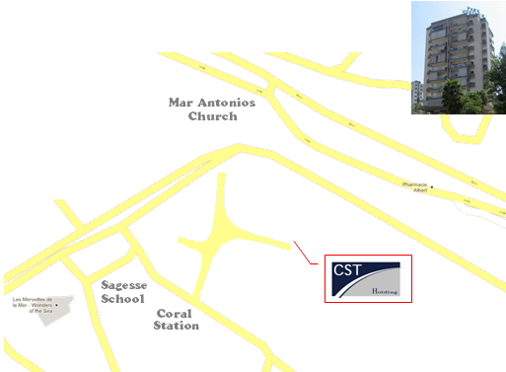
Contact CST Holding
CREDIT SYSTEMS & TECHNIQUES
PARK JDEIDEH CENTER - 2ND FLOOR - 12, 56 STREET - SECTOR 2 JDEIDEH - P.O.BOX: 11 - 4690 BEIRUT - LEBANON
Phone: 961 - 1 - 878125 / 879704
Mobile: 961 - 3 – 361901
Fax: 961 - 1 - 894242
Website: www.cst.com.lb
Email: admin@cst.com.lb
Overview
Key Values
Group Services
Departments
Database
Why CST
Facts
CST Clients
Contacts

Slide 44
Thank You
 Main

